Slide 1




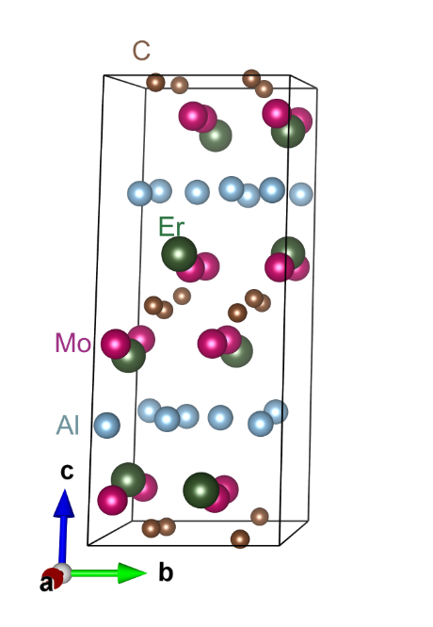
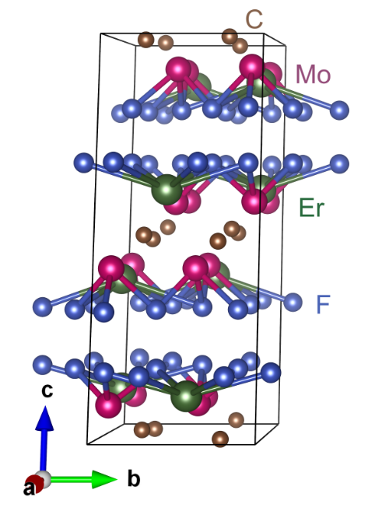
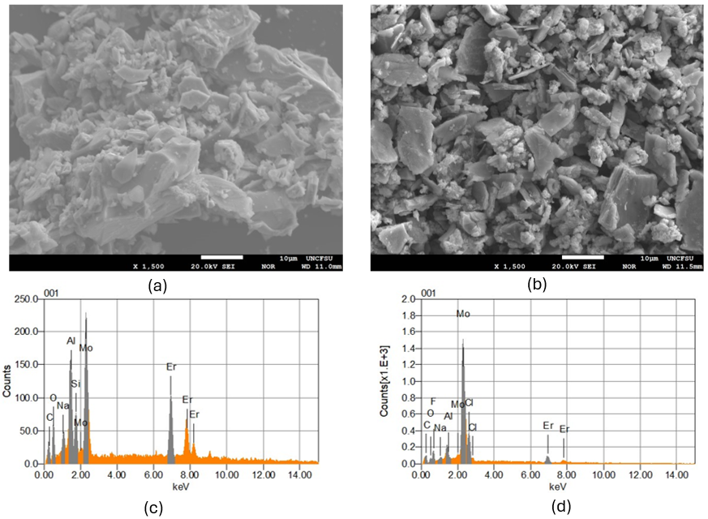
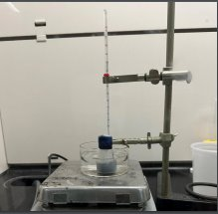
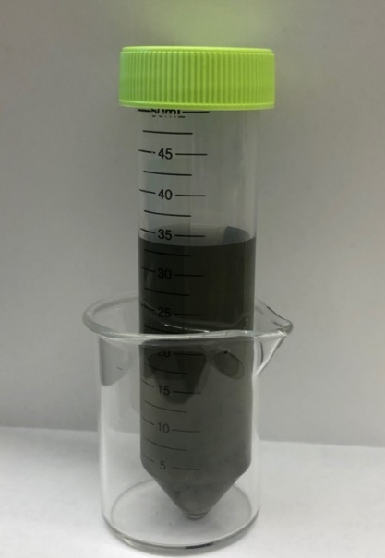
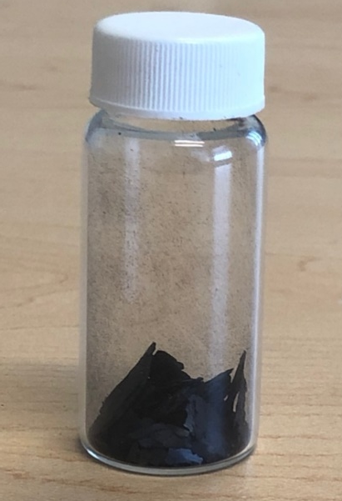
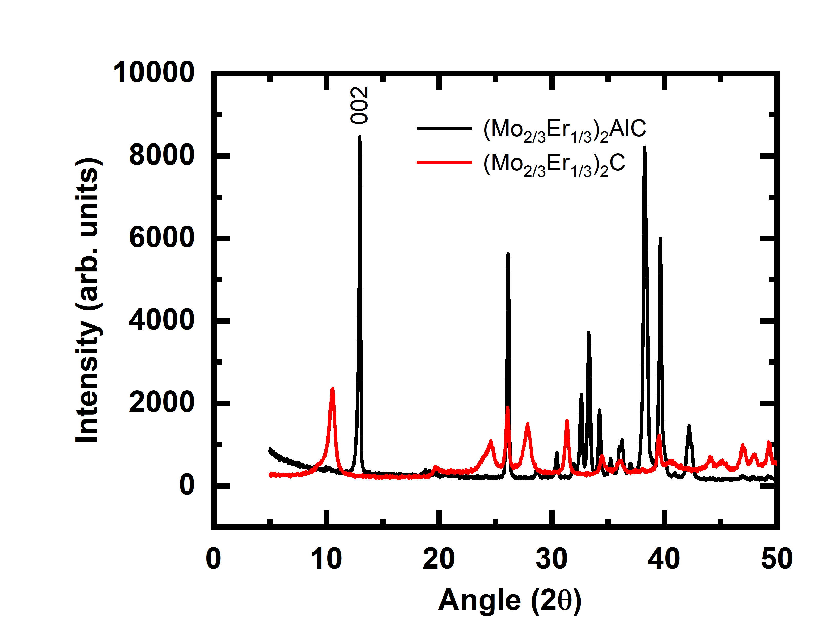
Structural and Morphological Characteristics of Rare Earth Element based MAX Phase and MXene
Joshua Abbott¹, Vanessa Morris ¹, Menuka Adhikari¹, Sangeetha Balabhadra¹, Alex Bretana², Binod Rai², Daniel Autrey¹, Bhoj Gautam¹
¹Department of Chemistry, Physics and Materials Science, Fayetteville State University, Fayetteville, North Carolina 28301, United States
²Savannah River National Laboratory, Aiken, South Carolina 29808, United States
Introduction
(Mo_{2/3}Er_{1/3})₂C
Morphology and Elemental Analysis
Materials
(Mo_{2/3}Er_{1/3})₂AlC
There has been a tremendous effort for the synthesis of crystalline MAX phases—a family of transition metal carbides and nitrides with a chemical formula of M_{n+1}AX_{n}, where M is an early transition metal, A belongs to groups XIII – XVI in the periodic table, X is either C or N, and n can be in between 1 and 3 [1]. These materials have shown thermal and electrical conductance and have low density and high stiffness which open broad aspects of practical applications. Recently double transition metal MAX phases (M’_{2/3}M’’_{1/3})₂AX - out-of-plane ordered, labeled as o-MAX and in-plane ordered, labeled as i-MAX, were reported [1,2]. However, there are few reports on the synthesis and characterization of i-MAX and the corresponding MXenes. In this work, we synthesized Molybdenum-based rare earth containing i-MAX phase using arc melt technique. We then removed “A” element of i-MAX phase by acid treatment and sonication which resulted in two-dimensional (2D) transition metal carbides called MXenes [3]. These MXenes offer high conductivity, hydrophilicity, magnetism, good dispersion ability in solvents, mechanical stability, and structural diversity with at least 100 stoichiometric MXene compositions and are recognized as multifunctional materials [4].
Etching
a
b
Figure 1. Chemical structure of (Mo_{2/3}Er_{1/3})₂AlC MAX phase and (Mo_{2/3}Er_{1/3})₂C Mxene. −F is a functional group introduced after LiF/HCl etching.
Sample Preparation:
Mild etching method
7 days at 70°C
Constant stirring
Oil bath
The resulting products were washed using HCl and deionized water, and vacuum dried at 70 ⁰C to remove any solvent residue.
Figure 4. Morphology and elemental analysis of (Mo_{2/3}Er_{1/3})₂AlC MAX phase and (Mo_{2/3}Er_{1/3})₂C MXene
Summary
(Mo_{2/3}Er_{1/3})₂C MXenes was synthesized using mild etching method.
The shifting and broadening of the (002) peak to lower angle was observed in MXenes compared to MAX phase.
The 39° 2θ peak related to aluminum is relatively small as in Mxenes relative to MAX phase.
More slate/sheet like structures were observed in (Mo_{2/3}Er_{1/3})₂C MXene compared to its MAX counterpart.
Atomic mass percentage of aluminum in (Mo_{2/3}Er_{1/3})₂AlC MAX phase is ~9% whereas it is below 1% after LiF/HCl Etching.
Figure 2. Photographs of etching, and decantate and prepared (Mo_{2/3}Er_{1/3})₂C Mxene ( left to right).
.
Abstract
XRD Results
In this work, the MAX phase with a nominal composition of (Mo_{2/3}Er_{1/3})₂AlC was synthesized using conventional arc melting in an argon atmosphere with a water-cooled copper hearth. (Mo_{2/3}Er_{1/3})₂C MXene was synthesized by adding (Mo_{2/3}Er_{1/3})₂AlC powders into the LiF/HCl solution and was etched for 7 days and washed using HCl and deionized water. The resulting product was vacuum dried to remove any solvent residue. Structural, morphological, and elemental characterization was carried out using X-ray diffractometer and scanning electron microscopy (SEM). The lowest Bragg peak of the (Mo_{2/3}Er_{1/3})₂AlC powder was shifted to towards smaller angle and the 39° 2θ peak related to aluminum is relatively small as compared to (Mo_{2/3}Er_{1/3})₂AlC. These results indicate the successful extraction of aluminum atoms from (Mo_{2/3}Er_{1/3})₂AlC. These results are further supported by energy dispersive spectrometry (EDS) measurements. Our results provide important information regarding the structural and morphological characteristics of rare earth element based i-MXenes which dictate the optoelectronic, magnetic, and electrochemical properties of these materials.
Acknowledgements
The synthesis of i-MAX phase and characterization work was supported by DOE BES-RENEW award number DE-SC0024611.This work was also partly supported by NSF RIA EES 1800795 for MXene synthesis.
a
b
References
[1] L. Verger et. al., Curr. Opin. Solid State Mater. Sci., 23 (2019) 149-163.
[2] M. Khazaei et. al., Phys. Rev. Mater., 2 (2018) 074002.
[3] Y. Gogotsi, B. Anasori, ACS Nano. 13 (2019) 8491-8494.
[4] W. Wang et. al., Science. 379 (2023) 1242-1247.
Figure 3. XRD patterns of (Mo_{2/3}Er_{1/3})₂AlC MAX phase and (Mo_{2/3}Er_{1/3})₂C MXene. The vanishingly small 39° peak indicates the successful removal of Al from (Mo_{2/3}Er_{1/3})₂AlC MAX phase. The broadening of the (Mo_{2/3}Er_{1/3})₂C MXene peaks indicate that
the MXene is amorphous. The shifting of the (002) peak to lower values indicates an increase in the interlayer separation (c-parameter).
Contact Information:
Dr. Bhoj Gautam, Department of Chemistry, Physics and Materials Science
Fayetteville State University, Fayetteville, NC-28301
Email: bgautam@uncfsu.edu, Phone: 910-672-1653

